Slide 1
Additional Line 18 Point Verdana

Slide 2
Technical Overview of GPDB
Presenter Name
Updated Q3, 2013 Pivotal Product Marketing

Slide 3












Pivotal Data Fabric Portfolio
Data Science
BI/Analytics Tools
Applications
Apps/Users
(Big) Data Staging Platform
Analytic
Data Warehouse
In Memory Data Grid
High-Speed Integration
Data provisioning, shared security, coordinated transformation
Data
Unstructured
Semi-structured
Structured
Notes:
If necessary, you can use this to remind customers of how we offer products which cover the entire range of needs for a modern data fabric. This ties out to the data fabric presentation which, ideally, they’ve already seen. But if they haven’t, you can tell a short version of the data fabric story here.

Slide 4
Pivotal Greenplum Database
(Big) Data Staging Platform
Analytic
Data Warehouse
In Memory Data Grid
High-Speed Integration
Data provisioning, shared security, coordinated transformation
Notes:
If necessary, you can use this to remind customers of how we offer products which cover the entire range of needs for a modern data fabric. This ties out to the data fabric presentation which, ideally, they’ve already seen. But if they haven’t, you can tell a short version of the data fabric story here.

Slide 5
The Analytic Data Warehouse
Pivotal Greenplum Database Overview

Slide 6
The Pivotal Greenplum Database is…
A Highly-Scalable, Shared-Nothing Database
A Platform for Advanced Analytics on Any (and All) Data
An Enterprise Ready Platform Capable of Flexing With Your Needs
Leading MPP architecture, including a patented next-generation optimizer
Optimized architecture and features for loading and queries
Start small, scale as needed
Polymorphic storage, compression, partitioning
Rich ecosystem (SAS, R, Chorus Studio, BI & ETL tools)
In-DB Analytics (MADlib, Custom, languages: R, Java, Python, PERL, C, C++)
High degree of SQL completeness so analysts can use a language they know
Domain: Geospatial, Text processing (GPText)
Available as needed – either as an appliance or software
Tightly integrated with other Pivotal products (Pivotal HD and Gemfire)
Secures data in-place, in flight, and with authentication to suit
Capable of managing a variety of mixed workloads with Pivotal VRP
Notes:
Use the primary three points as a framework to discuss the various features of the database. This is a good slide on which to explore what the customer is most interested in – so you know where to spend your time.

Slide 7
The Pivotal Greenplum Database Overview
A highly scalable shared-nothing database
A platform for advanced analytics on any (and all) data
An enterprise ready platform capable of flexing with your needs
Notes:
We’ll now cover each of these three subject areas in more depth starting with the architectural basis for Greenplum Database’s extreme performance: a highly scalable shared-nothing database that allows for massively parallel processing (MPP)

Slide 8

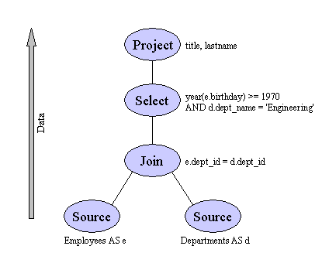

MPP 101: Performance Through Parallelism
SQL
Master Servers & Name Nodes
Query planning & dispatch
...
...
Network Interconnect
Segment Servers & Data Nodes
Query processing & data storage
...
...
External Sources
Loading, streaming, etc.
Notes:
NOTES: These are the key points to get across on this slide
This is “MPP 101” – how we enable parallelism
-Data distribution is key – minimize data skew and processing skew – we do this either by round robin, or by choosing a distribution key
-As you add segment servers, you add IO/Memory/CPU. Only thing that’s hard to add is *network*. This is why it’s important to distribute well, and to choose good query optimization plans.
-Our query optimizer is highly sophisticated – and treats network operations as having a query cost – a very powerful tool for efficiently using our precious resource - network
-Allows you to start small and go as large as you choose
-What makes up a GPDB cluster? Here are the moving parts & what they do:
More details to cover:
Massively parallel processing (MPP) is a distributed computing architecture where a big problem is broken up into a series of smaller problems that are executed in parallel
Shared-nothing:
With a shared-nothing architecture each node is independent and self-sufficient
Allows a system’s capability to be scaled incrementally (more detail on this one on the next slide)
When a node is added to the system storage space, i/o read/write speed, total memory, and cpu processing capabilities are all increased
The ability to add all of these system resources together incrementally means that a cluster’s overall capability does not bottleneck on one particularly constrained resource that can’t be further scaled: if you need more of a system resource you can always get it by adding more servers to the cluster
In contrast, shared-everything or shared-disk architectures can become bottlenecked on a shared-resource that cannot be further scaled, leading to a hard-ceiling on the cluster’s capabilities
Master/Segment Servers
Greenplum database (GPDB) is an MPP shared-nothing database
“Master servers” process user queries and pass query execution plans to the segment servers but don’t do any data processing themselves
GPDB “segment servers” are where the data processing actually takes place
Typically data is evenly distributed across all segment servers (the user can choose others schemes but random, even distribution is the recommendation and default)
GPDB segment servers all process the same query plan in parallel on data that is on their local disks
Highly performant interconnect
The “network interconnect” is a combination of both software and hardware
Commodity network hardware is supported, custom/expensive network hardware is not required
GPDB’s interconnect software ensures smooth operation of the network by performing tasks like “flow control” where nodes that need data from a node that is currently fully utilized are forced to wait instead of flooding the network with continual requests for the data
Parallel loading of external sources is covered in more detail in a following slide

Slide 9

MPP 102: True High Speed Loading
SQL
Parallelizes Everything
All nodes can process loading requests
No subsequent “Data Reorganization” steps.
Scales at over 10+TB/hr. per rack.
Only constrained by the speed of the source
Automates Parallelism
GPLoad utility automatically parallelizes file-based loading
Integrated with ETL products to parallelize ETL-based loading with minimal added effort
Master Servers & Name Nodes
Query planning & dispatch
...
...
ODBC/JDBC
Network Interconnect
Segment Servers & Data Nodes
Query processing & data storage
...
...
External Sources
Loading, streaming, etc.
PARALLEL LOADING
File Systems
PHD /Hadoop
RDBMS
GemFire
Streaming (Social Media, events, etc.)
Notes:
This slide should be used to describe GPDB’s load and extract capabilities and to highlight competitor shortcomings (if appropriate).
Make sure to cover:
Greenplum database supports fully parallelized loads that execute directly against the data nodes
Some competitor architectures force data being loaded onto the DB or pulled off the DB to always flow through the master server creating a bottleneck that slows down transfer rates
GPDB tools like EXTERNAL TABLES, EXTERNAL WEB TABLES, GPLoad, and COPY all natively know how to work directly with the data nodes without intervention by the master
External systems can load or extract data from GPDB as fast as their disks will read or write through using GPDB’s parallel load tools
A single rack of GPDB will typically support load/extract rates of 10 TB/hr
GPDB’s supported load/extract rates can be linearly extended through incrementally adding additional hardware: 2 racks will load 20 TB/hr, 3 will load at 30TB/hr, etc.

Slide 10
MPP 201: Start Small and Scale as Needed
...
...
Advantages:
Scale In-Place
No Forklifting
Immediately Usable
Simple Process
...
...
New Segment Servers
Query planning & dispatch
Notes:
This slide should be used to describe GPDB’s ability to be expanded incrementally and the flexibility and risk-mitigation that this provides for our customers.
Make sure to cover:
Greenplum database supports true incremental scalability
Additional capacity or processing capability can be added to GPDB server by server (or in larger increments if desired)
Some competitive architectures require “forklift” scaling: if you need additional capacity or processing capability you buy a bigger cluster, copy the data over from the old cluster, retire the old cluster, and pray that you correctly estimated how much capacity you’ll need for next several years
To take advantage of new hardware you simply plug it in and restart the database
To fully take advantage of the new hardware the existing data needs to be redistributed so that the new hardware contains an equal amount of data of the existing nodes (a common requirement for all architectures, not redistributing data means the new hardware is not being fully utilized)
GPDB’s redistribution tools are very flexible compared to competitors: data can be redistributed at full speed until complete, redistributed only during certain time periods, only redistributed when the system is no more than x% utilized, etc.

Slide 11
Advanced MPP: Polymorphic Storage™
TABLE ‘SALES’
Mar
Apr
May
Jun
Jul
Aug
Sept
Oct
Nov
Column-oriented for Full Scans
Row-oriented for Small Scans
Columnar storage is well suited to scanning a large percentage of the data
Row storage excels at small lookups
Most systems need to do both
Row and column orientation can be mixed within a table or database
Both types can be dramatically more efficient with compression
Compression is definable column by column:
Blockwise: Gzip1-9 & QuickLZ
Streamwise: Run Length Encoding (RLE) (levels 1-4)
Flexible indexing, partitioning enable more granular control and enable true ILM
Notes:
This slide should be used to discuss GPDB’s storage capabilities and to highlight the additional flexibility that GPDB has compared to its competitors.
Make sure you cover:
It’s often important to emphasize that although GPDB provides many options to optimize performance (such as the storage options described here) users are absolutely not required to go to this level of detail unless they’re really trying to get the absolute maximum out of their cluster. Out of the box appropriate defaults for typical customer workloads are used and further setting tweaks are optional.
Polymorphic storage:
Traditional relational databases typically use “row storage” meaning that all values on a database road are stored sequentially on disk
Row storage is often the appropriate storage pattern for OLTP queries (online transaction processing: typically queries return only a handful of rows)
Alternatively “column storage” where all of a column’s values are stored sequentially on disk is often the appropriate storage pattern for OLAP queries (online analytical processing: typically queries return values from a handful of columns but queries typically aggregate or otherwise process very large amounts of data)
GPDB supports both row and column storage. Typically for the majority of workloads we see column based storage is appropriate, but sometimes row based storage is better. On GPDB, in contrast to most competitors, you can choose whatever is appropriate
Additionally on GPDB table partitions (a way to subdivide tables to increase query performance) have almost all of the same options as available at the table level, consequently within the same table you can:
Use column or row storage for different partitions
Index an entire table or a subset of partitions
Define compression type and the level (1=light compression with little CPU overhead, 9=strongest compression at the expense of CPU cycles)
Collectively this flexibility is referred to as polymorphic storage
…Enables Information Lifecycle Management:
Polymorphic storage allows for customers to define data structures to match the realities of their information lifecycle
By information lifecycle we mean the tendency for query workload patterns to change over time
New rows are often more likely to be accessed in their entirety either to support more operational activities rather that typically access a greater percentage of a row’s contents to be more likely to be updated or deleted
Older rows are often more likely to be accessed by large analytical queries that only look at a handful of columns but aggregate data across a large period of time
Polymorphic storage and the partition by partition storage options, indexing strategies, and compression options means that a customer’s schema can be designed around a customer’s information lifecycle and provide optimum performance characteristics despite a dynamic workload

Slide 12
The Pivotal Greenplum Database at a Glance
CLIENT ACCESS
ODBC, JDBC, OLEDB,
MapReduce, etc.
3rd PARTY TOOLS
BI Tools, ETL Tools
Data Mining, etc
ADMIN TOOLS
GP Performance Monitor
pgAdmin3 for GPDB
CLIENT ACCESS & TOOLS
LOADING & EXT. ACCESS
Petabyte-Scale Loading
Trickle Micro-Batching
Anywhere Data Access
STORAGE & DATA ACCESS
Hybrid Storage & Execution (Row- & Column-Oriented)
In-Database Compression
Multi-Level Partitioning
Indexes – Btree, Bitmap, etc
LANGUAGE SUPPORT
Comprehensive SQL
Native MapReduce
SQL 2003 OLAP Extensions
Programmable Analytics
PRODUCT
FEATURES
ADAPTIVE
SERVICES
Multi-Level Fault Tolerance
Online System Expansion
Workload Management
Shared-Nothing MPP
Parallel Query Optimizer
Polymorphic Data Storage™
Parallel Dataflow Engine
Software Interconnect
Scatter/Gather Streaming™ Data Loading
CORE MPP
ARCHITECTURE
Notes:
This slide is a high level summary of GPDBs core components before we dive into analytics and other GPDB areas. Don’t read through this entire slide, but use it as a stopping points to take questions on the areas that you’ve already covered or to allow for questions on areas that you didn’t cover but fall into these areas.

Slide 13
The Pivotal Greenplum Database Overview
A highly scalable shared-nothing database
A platform for advanced analytics on any (and all) data
An enterprise ready platform capable of flexing with your needs
Notes:
Of course, if all we built was a fast database, we’d just be another Vertica. So we have built a number of analytic capabilities into Greenplum, and Pivotal in general. I’m going to spend the next twenty minutes or so going over these topics.

Slide 14
Analytical Architecture Overview
Data Access & Query Layer
ODBC
JDBC
Greenplum gNet
SQL
SAS
Stored Procedures
SQL 2003/ 2008 OLAP
MapReduce
In-Database Analytics
Polymorphic Storage
Greenplum Database
Notes:
NOTES: Unless your account requires you to focus on stored procedures, SQL compatibility or in db MapReduce, gloss over this slide quickly and move to the next one. Detail slides for stored procs, SQL OLAP and MapReduce are in the appendix.
SCRIPT:
Once we built a fast database engine, we enhanced it to make it user extensible. By doing so, we enable developers to build their own logic, embed that within the database to accelerate analytics.
The blocks in the center of this slide represent the 4 separate options we make available for users who want to write analytics that run directly inside either the database software inside the Data Computing Appliance or DCA. Each provides you with options to extend the database in ways which make sense for your business.
I can talk with you at length about stored procedures, SQL server compatibility and mapreduce, but our customers don’t usually get very excited about those things. They’re usually most interested in the in-database analytics.”
NOTES: If you need to provide summaries of the items, the text is below:
The first and most common method for accelerating analytics is to use traditional SQL stored procedures. Written in SQL, stored procedures can be used to encapsulate logic that will run repeatedly, effectively adding user-defined functions to SQL.
But SQL is not the most effective language for complex computational tasks. Let’s look at some more analytics-focus methods.
NOTES: Don’t spend much time here - stored procedures will be very familiar to database software developers, but will not provide huge performance gains. And this is not a big value add feature for GPDB – it’s long been a commodity database feature.
The SQL language was enhanced in 2003 to add OLAP – Online Analytical Processing extensions that can be used to accelerate certain simple aggregations without any custom programming.
Greenplum SQL processing supports the extensions for OLAP that were added with SQL 2003 including cube and grouping set extensions, SQL 2003 ordered aggregates extensions, windowing functions, etc.
NOTES: Again, SQL 2003 needs to be covered only briefly.
For certain kinds of analytical tasks, a new programming paradigm is available. MapReduce was pioneered at Yahoo and others, to allow Java and Python developers to build software programs that run in a batch-oriented way to do large bulk information processing tasks on huge volumes of data by breaking the task up to run on many processors.
Originally coupled with a massively parallel system called HDFS, many programmers are learning how to use MapReduce in colleges around the country. These same young developers typically do NOT learn SQL, and so by adapting the MapReduce programming environment to run within Greenplum Database, these young developers can be immediately productive, without becoming SQL or SAS experts.
And, it’s extensible. For developers who do know SQL, MapReduce tasks can invoke SQL to get data to use in calculations or access the data in the database programmatically.
Most importantly, developers can, through MapReduce, run tasks that access data in GPDB, massively parallel, without using SQL, and at very high performance rates.
NOTES: Watch out for Hadoop bigots here. If they’re hung up on Hadoop, make a note of it and decide whether a followup conversation on Pivotal HD + HAWQ makes sense.
Finally, and most importantly, GPDB offers a very powerful set of in-database extensions – offering users a number of powerful ways to harness MPP computation when solving complex problems. Let’s dive into this block.
NOTES: If you are asked for more detail about our implementation of MapReduce:
Our MapReduce API is added to Greenplum Database and gives access for programmers to data stored in the database – structured data. This means that the programming environment will look familiar to developers and are written to access data in a format other than HDFS.

Slide 15
In-Database Analytics: Detail
Data Access & Query Layer
ODBC
JDBC
SQL
In-Database Analytics
Greenplum DB Embedded Analytics
SAS Scoring Accelerator
MADlib
Open Source Analytical Algorithms
User-Written Analytical Algorithms
Embedded
Partner
SAS/HPA
High Performance Analytics
Open-Source
Greenplum Spatial
Customized
MADlib
Customized
Greenplum Text
SAS Access
SAS Grid
User-written
Greenplum Database
Notes:
NOTES: Unless you’re selling speeds & feeds, this is one of your most powerful slides. This opens the door to our analytics story, which is one of the best on the market. There are additional slides in the appendix with additional details on these items.
SCRIPT:
Greenplum has some of the richest analytics offerings in the MPP database market today.
First, we offer a set of built in analytics via ANSI window functions that act as workhorse functions. For example, if you need to enrich data on a load with a ranking, or a row identifier within a window, or compare a current row value to the average of the previous three rows – we offer all these as built in functions which you can call via SQL, and which leverage all the performance of the database.
And we also offer extensions specifically for spatial and text analytics. Greenplum Spatial allows you to express various geographic objects in-database, and to run queries against that data to do things such as find the number of households within a particular distance of a store – a common retail analytics task. Greenplum Text allows you to index and query unstructured data in-database. Even more interesting is that this also enables a process called “feature extraction” – which enables you to classify text for things such as sentiment analysis…a very powerful technique for identifying the emotional content of text.
We also are very tightly integrated with SAS – offering everything from direct access to Greenplum tables from SAS, to embedding SAS scoring models within the database, to running SAS in parallel adjacent to the database. I’m happy to share more details if you’re using SAS today.
One of the most interesting features of Greenplum is MADlilb. MADlib is a collection of open-source routines for analytics – providing everything from correlations to K-means clustering, regression and even support vector machines. Greenplum was one of the founding contributors to MADlib, and remains active in it’s development. MADlib also includes support for things such as matrix and array processing for customers who want to develop their own in-database analytics.
Finally, Greenplum supports the development of analytics in a variety of languages such as the R language, which will run in-database and leverage all the speed and capabilities of the platform.

Slide 16
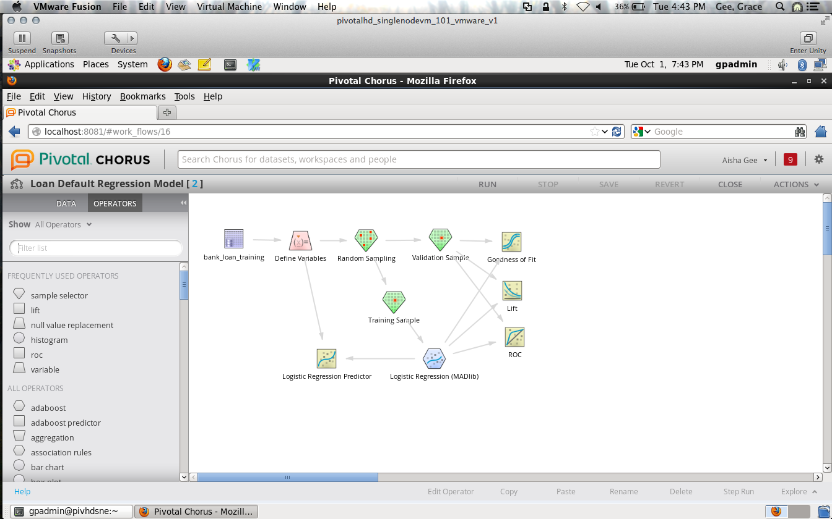
Chorus Analytics Studio
Create, store, and share visual analytic workflows
Build analytic flows for Greenplum, HAWQ, and Hadoop
Powered by Alpine and MADlib
75+ drag-and-drop operators for the entire analytics process
MADlib algorithms in-database
Notes:
NOTES: Chorus 3.0 is an additional product purchased separately from Greenplum. Version 3.0 embeds the Alpine Labs analytics.
SCRIPT
Chorus is an environment for the collaborative development of analytics across a variety of big data platforms such as the Pivotal Greenplum Database and Pivotal HD with HAWQ.
It’s powered by Alpine Labs and MADlib, and provides a very rich library of built in operators for data preparation, enrichment and analysis:
It provides over 75 drag-and-drop operators for the entire analytics process including
Data prep and visualization
Building and testing predictive models
Using predictive models to score data
Push-down operations to run models at full scale within Greenplum
If you don’t already have a tool for developing analytics, Chorus may be the right tool for you – it’ll greatly simplify the development of complex analytics, allow for the sharing of those analytic flows & results, and leverage your investment in the Greenplum database for maximum performance & efficiency, and ease of support.
ADDL INFO:
Includes 5 MADlib algorithms: linear regression, logistic regression, elastic net regularization, k-means clustering, decision trees
Including validation, visualization, and scoring functions
New algorithms, optimized performance on GPDB

Slide 17


























Data & Analytics Technology Ecosystem
Analytics
Business Intelligence
Data Integration
Social Media Services
Data Modeling
Notes:
NOTES: This is a variant of the standard NASCAR slide. The point here is that we have a very large (and growing) ecosystem, including cutting edge partners such as Gnip to enable social media analytics. Use this slide to identify key ecosystem components your customer may be interested in.
SCRIPT
This is a partial list of the technologies we work with closely. If you’re like most businesses, you use at least a half dozen of these. (use as avenue for discovery)

Slide 18
Solving Real World Analytics Problems at Scale
GPDB’s performance and scale, combined with built-in analytics and data science expertise, has solved very tough business problems:
Predict Security Prices
RNA Sequencing
Predict Customer Engagement
Network Intrusion Detection
Predict Traffic Patterns
Credit Stress Testing
Predict Churn (1600x Faster)
SQL
Sentiment
Machine Learning
Text
Processing
Custom UDFs
Graph
High Performance, Highly Scalable Database Engine
Greenplum Database
Notes:
NOTES: When we combine together the fast platform with advanced analytics, we open the door to solving many different problems. Here are just a few problems which our team has actually solved with customer data. And this is just a partial list. The point here is synergy – the sum of the fast Greenplum database engine with the ease of use of SQL and the built-in analytics opens the door to solving many analytics problems.
SCRIPT
So we’ve talked about the Greenplum database engine – a high speed, scalable MPP database platform, and our embedded analytics such as MADlib, GPText, and spatial. When we put those things together we get an analytic platform which is greater than the sum of the parts. What you see here are just a few examples of the analytic problems we, and our customers have solved using Greenplum. Furthermore, since many of our customers don’t employ data scientists, we can also bring expertise to the table in the form of our Data Science team – who has helped dozens of our customers solve tough analytic problems…in days…across the full scale of their data.
ADDL INFO
NOTES: Below are the specific GPDB components which went into solving each of the things cited on the slide, in case anyone asks.
Predict Security Prices = MADlib + GPtext + Sentiment Analysis
High Speed RNA Sequencing = MADlib + Custom UDFs
Predict Cross Channel Customer Engagement = MADlib + GPtext
Network Intrusion Detection = MADlib + Machine Learning + Graph
Predict Traffic Patterns = Big Data + MADlib + Machine Learning
Credit Stress Testing = Big Data + MADlib + Ecosystem
Predict Churn (1600x Faster) = Big Data + MADlib + GPtext

Slide 19
The Pivotal Greenplum Database Overview
A highly scalable shared-nothing database
A platform for advanced analytics on any (and all) data
An enterprise ready platform capable of flexing with your needs
Notes:
Talk to future cloud deployments

Slide 20



Deployment Choice & Flexibility
The Data Computing Appliance (DCA)
Modular Flexibility
Database, Hadoop and ETL Modules
Future Partner-Specific Modules
Common Admin and Network Mgmt.
Incremental Scalability
Rapid Deployment
Software Only
Deploy on your x86 hardware
Certified Configurations
Perpetual or Subscription License
Community Editions
Database
Notes:
You can deploy our software pre-installed in our Data Computing Appliance (DCA) or you can install it in your hardware. With Greenplum the choice is yours.
We offer the DCA with Greenplum pre-installed on it. This has the advantages of easy set-up with the OS and Greenplum preloaded. It also includes special DCA software that monitors the system and dials home if any issues occur.
Of course you can build your own hardware cluster, install and run Greenplum on it. The benefit here is cost savings

Slide 21
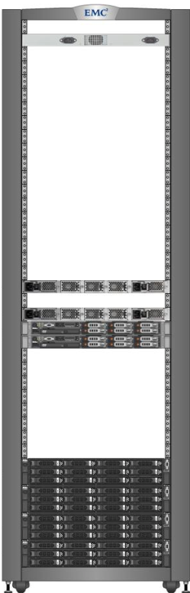
The Pivotal Data Computing Appliance: Modular Options
1st Rack
Additional Racks
Modules:
Pivotal Greenplum Database
Pivotal HD
Pivotal Data Integration Accelerator
Multiple module versions available tailored to workload requirements
¼ Rack Minimum
Incremental Scale
Greenplum Database Modules
Functional
Module
Greenplum Database Modules
Functional
Module
Functional
Module
or
Functional
Module
or
Greenplum DIA Module
+
Greenplum DIA Module
or
or
Functional
Module
Functional
Module
Pivotal HD Module
Pivotal HD Module
Greenplum Database
Module
(required)
Functional
Module
Add ¼ rack
Increments
Add ¼ rack
Increments
Notes:
Our DCA systems are very flexible
You can host GPDB, Hadoop and other software (such as ETL, analytics, or database management) within the same Rack.
NOTES:
Multiple flavors of Greenplum, DIA and Hadoop modules:
GPDB:
GPDB Standard (4x 2U servers, 16 cores each, 64GB RAM, 24x900 SAS drives)
GPDB Compute (as above, except 24x300 SAS drives)
GPDB High Memory (256 GB RAM, 24x300 SAS drives, otherwise as Standard module)
DIA:
DIA Standard (2x 1U servers, 16 cores each, 64GB RAM, 6x300 SAS drives)
DIA SATA (as above, except two 2U servers, 12x3TB SATA 7.2K drives)
DIA Mem (Two 2U servers, 16 cores each, 256GB RAM, 24x300 SAS drives)
Pivotal HD
HD Master (4x 2U servers, 16 cores each, 64GB RAM, 12x3TB SATA)
HD Data (4x 2U servers, 16 cores each, 64GB RAM, 12x3TB SATA)
HD Compute (2x 1U servers, 16 cores each, 64GB RAM, No storage, For use with Isilon)

Slide 22


High Performance Integration with Hadoop
Parallel Query Access
Connect any data set in Hadoop to GPDB SQL Engine
Process Hadoop data in place
Parallelize movement of data to/from Hadoop thanks to GPDB market leading data sharing performance
Supported formats:
Text (compressed and uncompressed)
binary
proprietary/user-defined
Support for Pivotal HD, MapR, Hortonworks, Cloudera
gnet for Hadoop
Text
Binary
User-Defined

Slide 23
Comprehensive High Availability
Master and Segment Mirroring with block level replication
Low resource consumption
Differential resynch capable for fast recovery
Minimize interdependencies!
Segment servers support multiple database instances
Primary instances that actively process queries
Standby mirror instances
Segment
Server 1
P1
P2
P3
M6
M8
M10
Segment
Server 2
P4
P5
P6
M1
M9
M11
Segment
Server 3
P7
P8
P9
M2
M4
M12
Segment
Server 4
P10
P11
P12
M3
M5
M7
Set of Active Segment Instances
Notes:
Redundancy at every level
GPDB cluster
2 Master servers
Multiple Segment servers
Segment servers support multiple database instances
Primary instances that actively process queries
Standby mirror instances
Block level replication
Low resource consumption
Differential resynch capable for fast recovery
As mentioned before the master server has both primary and standby
Each segment server can have multiple segments (P1, P2, P3)
Each segment has a mirror that is written to a different disk (M1, M2, M3)

Slide 24
Comprehensive Backup/Restore
Full and Incremental backup support with in-database tools
Incremental backup
Only changed partitions are pulled for the backup
Restore to any point-in-time through support of “synthetic restores”
Synthetic restores automatically assemble the right backup based on the point-in-time specified: manual backup specification is not required
Deep support for Data Domain
WAN replication of backup sets to remote DR sites
Granular delta-only backup support
Notes:
We offer full integration with Data Domain
Data Domain acquired by EMC in 2009
Data Domain
File system Appliance
Disk based – built as a replacement for older tape automation system
Includes a very fast implementation of lossless data compression
Allows
in-line data records
And offsite disaster recovery
Simple fast restore
RPO: Recovery point objective
RTO: Recovery time objective
Improves IT efficiency
Eliminates the requirements of tape storage
Throughput of 31 TB/hr
Total sizes of 28.5 petabytes of logical storage
Data Domain Boost
Pushes much of the deduplication processing to the processing nodes
Dramitically increases speed by 50%
Reduces amount of data transferred over the network by 80 – 99%
Load balancing and failover

Slide 25
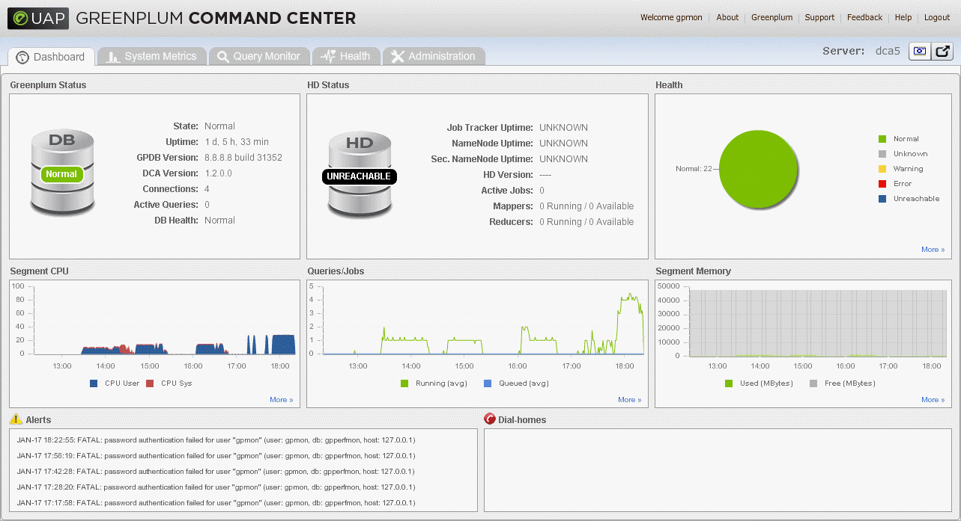
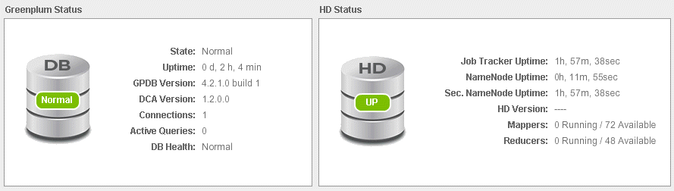
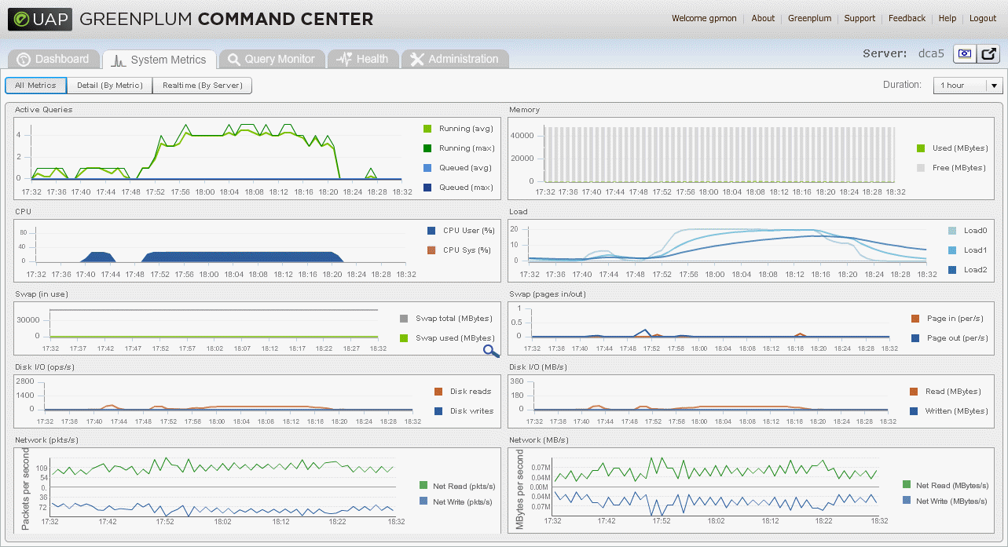
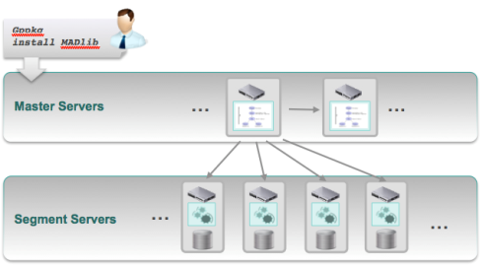
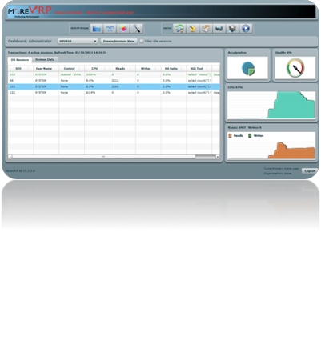
Comprehensive Management Tools
Single console for software plus DCA
Supports easy deployment of database extensions
Manage Workloads with PivotalVRP
Manage the Database with Command Center
Manage Analytics & Extensions with gpPkg
Best in class workload monitoring, management and performance tuning
Notes:
Fully featured database monitoring, management and performance tuning
Accelerate database queries in real-time
Replay database activity to determine root cause of performance problems
Automatically activates rules to optimize database performance
Measure and charge resource consumption per tenant in a private or public cloud
These are zero-cost items included with Greenplum

Slide 26
Demo

Slide 27
Data Loading Methods

Slide 28
Data Load Options
SQL INSERT
Standard Row by row insert – slowest method
INSERT into tableX VALUES (‘John’, ‘Doe’, ‘Manager’)
All data is passed through Master server
PostgreSQL Copy command
Inserts data from a file or stdin (another query) – faster than SQL INSERT
COPY tableX FROM {file | STDIN}
All data is passed through Master server
Parallel loading with gpfdist/gpload
Segment servers connect directly to external files served via gpfdist
Load bypasses Master server
Segment servers load in parallel
External tables point to the streamed files
CREATE EXTERNAL TABLE ext_table LOCATION (gpfdist://dir/*)
CREATE TABLE tableY AS SELECT * FROM ext_table
Integrated with Informatica PowerExchange and Pentaho

Slide 29


SQL Insert Method
Client
Ii tw ro kad jh
Ii tw ro kad jh
Ii tw ro kad jh
Ii tw ro kad jh
Master
Segment
Segment
Segment
…
Segment

Slide 30
PostgreSQL Copy Method
Client
Ii tw ro kad jh
tom Jerry 123
joe blow 456
larr white 789
Master
Ii tw ro kad jh
Ii tw ro kad jh
Ii tw ro kad jh
Ii tw ro kad jh
Segment
Segment
Segment
…
Segment

Slide 31
Parallel Load with gpfdist
ETL Host
Client
Ii tw ro kad jh
tom Jerry 123
joe blow 456
larr white 789
gpfdist
Ii tw ro kad jh
Ii tw ro kad jh
Ii tw ro kad jh
Ii tw ro kad jh
Ii tw
Master
Segment
Segment
Segment
…
Segment

Slide 32
Parallel Load with gpfdist
…
ETL Host
ETL Host
Client
gpfdist
Ii tw ro kad jh
tom Jerry 123
joe blow 456
larr white 789
Ii tw ro kad jh
tom Jerry 123
joe blow 456
larr white 789
gpfdist
Ii tw ro kad jh
Ii tw ro kad jh
Ii tw ro kad jh
Ii tw ro kad jh
Ii tw ro kad jh
Ii tw ro kad jh
Ii tw ro kad jh
Ii tw ro kad jh
Ii tw
Master
Segment
Segment
Segment
…
Segment

Slide 33
Parallel Load with Informatica, Pentaho, etc.
ETL Host
…
ETL Host
Informatica
Informatica
Client
Ii tw
Master
Segment
Segment
Segment
…
Segment

Slide 34
Data Distribution and Partitioning

Slide 35
Table and Data Distribution
Technique for balancing workload across all nodes
All database tables are distributed across all Segments
Distribution Policy determines how the data in the tables is distributed
Hash Distribution (Default)
One or more columns used as distribution key
Hashed into “Buckets” for each Segment
Unique keys assure even distribution
When key is unspecified - uses Primary key or first column
Random Distribution
Round-Robin distribution of rows to Segments
Evenly distributes data but may be less efficient at query time

Slide 36
Distribution
Create Table tableX … Distributed by CustomerID;
Client
Master
Segment
Segment
Segment
Segment
TableX

Slide 37
Distribution
Create Table tableX … Distributed by CustomerID;
Client
Master
Segment
Segment
Segment
Segment
TableX

Slide 38
Distribution
Create Table tableX … Distributed by Gender;
Client
Master
Segment
Segment
Segment
Segment
TableX

Slide 39
Distribution
Client
Master
Segment
Segment
Segment
Segment
Choosing a poor distribution value causes Skew
TableX

Slide 40
Table Partitioning
Technique for eliminating rows at query time
Logically divides a large table into smaller parts
Significantly improves query performance
Facilitates database maintenance
Two types
Range partitioning
List partitioning
Partitioning in Greenplum works using table inheritance and CHECK table constraints
Partitioned tables also have distribution keys
Notes:
Instructor Notes
Table partitioning addresses the problem of supporting very large tables, such as fact tables, by allowing you to divide them into smaller and more manageable pieces.
The advantages of partitioning are to improve query performance by scanning only the relevant data needed to satisfy a given query.
It can also be used to facilitate database maintenance tasks such as rolling old data out of the data warehouse or speeding up the update of indexes.
GPDB supports both range partitioning (division of data based on a numerical range, such as date or price) or list partitioning (division of data based on a list of values, such as gender or region), or a combination of both types.
Table partitioning in GPDB works using table inheritance and constraints. Table inheritance creates a persistent relationship between a child table and its parent table(s), so that all of the schema information from the parent table propagates to its children. CHECK constraints limit the data a table can contain based on some defining criteria. These constraints are also used at runtime to determine which tables to scan in order to satisfy a given query.
In Greenplum DB partitioned tables are also distributed across the segments as is any non-partitioned table. Partitioning is more of a tool to logically divide big tables to improve query performance and maintenance. It does not effect the physical distribution of the table data.

Slide 41
Partitions
Single Partition
Create Table tableX … Distributed by CustomerID;
Client
Master
Segment
Segment
Segment
Segment
TableX

Slide 42
Partitions
Single Partition
Create Table tableX … Distributed by CustomerID;
Client
Master
Segment
Segment
Segment
Segment
TableX

Slide 43
Partitions
Query
Select * from tableX … Where Color = ‘Blue’;
Client
Master
Segment
Segment
Segment
Segment
TableX

Slide 44
Partitions
Multiple Partitions
Create Table tableX … Distributed by CustomerID Partition by Color;
Client
Master
Segment
Segment
Segment
Segment
TableX

Slide 45
Partitions
Multiple Partitions
Create Table tableX … Distributed by CustomerID Partition by Color;
Client
Master
Segment
Segment
Segment
Segment
TableX

Slide 46
Partitions
Query
Select * from tableX … Where Color = ‘Blue’;
Client
Master
Segment
Segment
Segment
Segment
TableX

Slide 47
When To Partition?
Have a large (fact) table
Query predicates have identifiable access patterns
e.g., WHERE trans_date >= ’07/01/2012’) AND trans_date < ’08/01/2012’
Need to maintain a “rolling window” of data
Data can be divided into somewhat equal parts based on some defining criteria
Experiencing unsatisfactory performance

Slide 48
Backup and Recovery

Slide 49
Backup in a nutshell
Option 1: custom external tables
Good control over which tables/data to backup
Enables incremental backup
Doesn’t include other objects, such as roles, resource queues, etc.
Option 2: pgdump
Free utility
Not parallelized
Creates one dump file on the master
Option 3: gpcrondump
Free utility
Parallelized backup
Creates SQL files on the master and segment hosts
Must restore to same number of hosts/segments
Incremental backup not supported
Option 4: Data Domain
See next slide
Notes:
Backup Options
-----------------------------------
Option 1 (but not really an option): pgdump.
- free utility created for postgres database
- backup is not parallelized
- creates one big dump file on the master
- only useful when migrating GPDB to an SMP database (SQL Server, Oracle, etc)
Option 2: gpcrondump/gp_restore
- free utility
- parallelized backup & restore
- can backup the schema, the data, and objects (users, roles, etc)
- during dump, users still have access to the system
- creates SQL files on the master and segment hosts
- must restore to same number of hosts/segments
- incremental backup not supported
Option 3: Data Domain
- more efficient, turn-key backup
- parallel backup & restore
- better compression
- de-duplication for lesser storage requirement
- only changed data is moved to the data domain devie
- can use NFS-mount or DD Boost:
NFS: data domain device mounted as NFS storage on DCA. De-duplication happens on data domain device
DD Boost: software on the DCA segments hosts. De-duplication pushed to the GPDB segments. Less is transferred to data domain device. Faster than the NFS option
Option 4: SAN Mirror
- effectively doubles the size of the DCA, as mirrors are on the SAN instead of the database segment servers
- this may be going away when DCA v2 is released later in the year

Slide 50
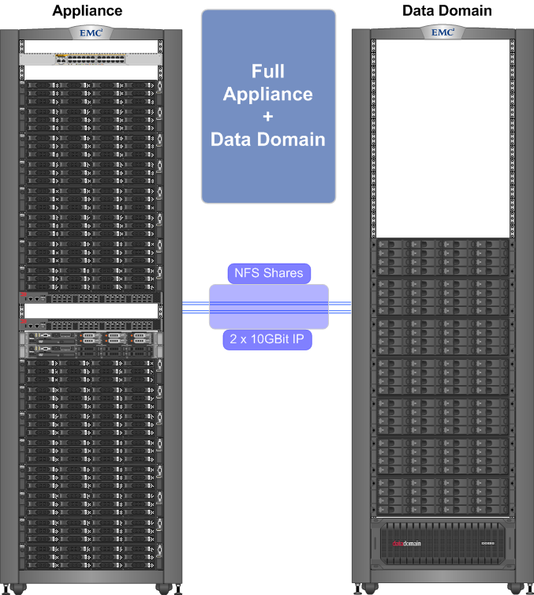

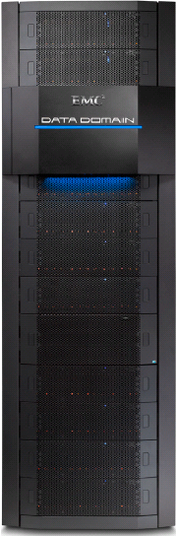
Efficient Backup/Restore with EMC Data Domain
Back up protocol options
NFS: Data Domain device mounted as NFS storage. Direct IO option available in 4.1.2.3 or 4.2.2 or higher
DD Boost: Native, client-side deduplication, dedicated communication. Requires 4.2.1 or higher
Data Domain deduplication is an ideal fit for Greenplum
Integrates seamlessly into standard Greenplum full backup data export and data restore procedures
Drastic reduction in backup storage requirement
Backup all segment servers in parallel directly to Data Domain
Backup/Restore at Full or Table level
DD Boost or NFS
Notes:
DD Boost for Greenplum meets the challenge of backing up big data by leveraging the massively parallel processing architecture of Greenplum supporting multiple parallel streams from the Greenplum Database to the Data Domain system. The DD Boost plug-in for Greenplum increases backup performance by distributing parts of the deduplication process to the Greenplum Database server. With this integration, only unique data is sent from the Greenplum Database to the Data Domain system, which reduces LAN bandwidth required by 80 to 99 percent.

Slide 51
High Availability

Slide 52
Greenplum Segments
A database instance
Works in parallel with other Segments (instances) to process SQL (loads and queries)
Client
Master
Segment0
Segment1
Segment2
Segment3
Segment4
Segment5
Segment6
Segment7

Slide 53
Segment Hosts
Physical servers that holds some number of Segments (instances)
Dedicated CPU and storage that is not shared with other Hosts
High speed interconnect between Segment Hosts
Client
Master
Segment0
Segment1
Segment2
Segment3
Segment4
Segment5
Segment6
Segment7

Slide 54
Mirroring
Protects Segment Instances from host failures
Mirror Segments
Warm standby for Primary Segment
Continuously updated with data from Primary
Spread across Segment hosts
Client
Master
Primary0
Primary1
Primary2
Primary3
Primary4
Primary5
Primary6
Primary7
Mirror6
Mirror5
Mirror0
Mirror7
Mirror2
Mirror1
Mirror4
Mirror3

Slide 55
Failover
Master continuously monitors segments
If no response, initiates failover to Mirror Segments
Client
Master
Primary0
Primary1
Primary2
Primary3
Primary4
Primary5
Primary6
Primary7
Mirror0
Mirror5
Mirror6
Primary0
Mirror7
Primary1
Mirror1
Mirror2
Mirror3
Mirror4

Slide 56
Workload Management

Slide 57
Workload Management
Database Roles
Users and Groups
Controls permissions and access
Resource Queues
Controls number of concurrent queries
Controls allocation of processing power to queries

Slide 58
Database Roles
Manages access to objects and operations
CREATE ROLE jsmith WITH LOGIN;
GRANT INSERT ON mytable TO jsmith;
Roles can also be used as Groups
CREATE ROLE admin CREATEROLE CREATEDB;
GRANT admin TO jsmith, sally;

Slide 59
Roles
User
Group
Joe
Finance
Larry
Sue
Exec
Apache
Web
BOBJ
Batch
ETL
Ad Hoc

Slide 60
Resource Queues
Controls query concurrency and priority
Roles are assigned to Resource Queues
Queues can have multiple roles assigned
A Role can only be assigned to one Resource Queue
Queue Limit options
Count Limit – Max number of active queries in the queue
Cost Limit – Max Query Planner cost of active queries in the queue
Minimum Cost Limit – Queries below this cost are not queued but run immediately
Can be specified with either Max Count limit or Max Cost limits
Queue Priority
Specifies Min, Low, Medium, High, Max Resource utilization
Priority | Weight
Min | 100
Low | 200
Medium | 500
High | 1000
Max | 1,000,000

Slide 61
Resource Queues
User
Group
Resource Queue
Joe
Finance
Larry
Sue
Exec
Resource Queue
Apache
Web
BOBJ
Batch
Resource Queue
ETL
Ad Hoc

Slide 62
Queue Limit: Active Statement Count
Waiting Statements
Active Statements
?
?
?
?
?
Min Cost = 10K
?
Queue Limit = 4
Resource Queue

Slide 63
Queue Limit: Active Statement Cost
Waiting Statements
Active Statements
?
?
?
25K
75K
25K
Min Cost = 10K
?
Query Cost Limit = 100K
Resource Queue

Slide 64
Queue Limit: Active Statement Cost
Waiting Statements
Active Statements
?
101K
Min Cost = 10K
Query Cost Limit = 100K
Resource Queue

Slide 65
Queue Priority
Total Resource Utilization
Resource Queues
100%
?
Max
?
?
Medium
?
Qry1
Qry2
Qry3
Qry4
Low

Slide 66
Align Queue Resource to Business Priorities
Queue Function | Priority | Active | Min Cost | Max Cost | Over-commit
Batch ETL / ETLT | Low | 25
Trickle Feed ETL / ETLT | Low | 10 | 10k
Web App / BI Parameterized Reports | High | 50 | 5k
Ad-Hoc, Power Users | Med | 5 | 10k | 150m | Yes
“VIP” Queue (with tripwire) | Max | 3 | 10k | 50m | Yes
Data Mining | Min |  |  | 500m | Yes
“Cartesian Threat” or “Penalty Box” | Min |  |  | 150m | No
Default Queue, if none assigned | Med | 20 |  |  | No
Notes:
Costs are floats, so must have a decimal point. 10k would be entered as 10000.0, 150m would be 150000000.0, and so forth
Costs are seen (floats, so there’s always decimals) in EXPLAIN or EXPLAIN ANALYZE statements. One unit is roughly equivalent to 1 disk 32k page fetch I/O, with the following adjustments. Query costs are increased for additional CPU activity such as calculations, aggregate functions, GROUP BYs and sorts. Since the GP planner favors sequential I/O, random I/O will also increase the cost. Index scans are the primary example of random I/O. The scan of the index itself is sequential, but the page fetches that they trigger are not.
Random fetch cost estimates are controlled by the GUC switch random_page_cost. The default value is 100, or 100 x the cost of a sequential page fetch. It’s a runtime switch, so developers can test different values for a given query to see if it generates a better plan. Warning - It’s highly dis-recommended to change this switch globally, as it would affect all queries. GR note: If the underlying storage is SSD and not magneto-resistive, I could easily be persuaded to reduce random costs globally. SSD can support thousands of times more seeks per second than magneto-resistive and is right in the GPDB “sweet spot”.
Sequential fetch cost estimates are controlled by the GUC switch seq_page_cost. The default is 1 and should not be changed, even though it’s a runtime switch. For developers tuning problematic queries, the best practice is to use the runtime switches enable_seqscan and enable_indexscan. By trying different combinations and evaluating the plans, the optimal one will emerge.
Please refer to Appendix D in the Admin Guide for all the fine print on these GUC switches. Otherwise, query plans will not always turn out the way you thought they should. Rather than inscrutable or even obstinate, the Greenplum query planner is an advanced, complex, and powerful expert system, and has mathematical reasons for doing what it does. The planner reserves the right to disregard GUC switches if compliance would be a disaster, or, more charitably, sub-optimal.

